Slide 1


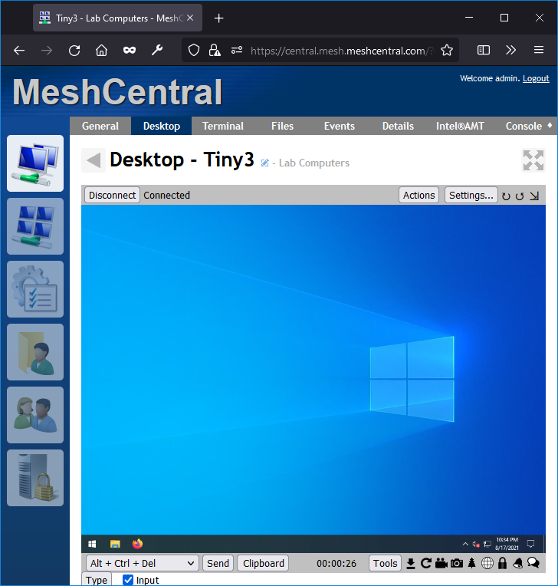

MeshCentral
TLS 1.3 Encryption
Mesh Agent
MeshCommander

